Slide 1
Full Year Results: Year ended 31 March 2019
Chairman: Robin Williams
Chief Executive : John Foster
Notes:
Delete space between Executive and :

Slide 2
Results Overview : Year ended 31 March 2019
Underlying pre tax profits £3.9m (2018: £3.2m) + 19%
FIC: Profits up 12% to £1.50m (2018 : £1.34m) - medium term prospects encouraging.
Momart: Continued strong growth – PBT up 51% to £1.57m (2018 £1.04m) – helped by non-recurring £0.2m release of provision.
PHFC: Profits lower by £0.08m to £0.78m - on stable revenues – strong cash flow.
Reported PBT £3.9m (2018: £3.3m)
Diluted EPS on underlying profits + 20% to 24.1p (2018: 19.7p)
Final dividend 3.35p proposed +11.6% (Full year 5.0p ( 2018: 4.5p))
Cash balances £6.2m (2018: £17.0m) following £20m Leyton property purchase in December 2018.
Bank debt £12.8m (2018: £3.3m) – incl £10m property related loan now being replaced by committed long term mortgage facilities of £13.9m.
Outlook - Steady underlying growth in near term + encouraging medium term outlook from oil and infrastructure opportunities in Falklands, and storage growth at Momart.
Notes:
FIC: “Pre-tax profit 12.5% up to £1.51m (2018: £1.34m)” is the stat we’ve used in press release/highlights page.
Delete extra spaces between 2018 : £1.34m)and also in the final dividend line there is a space to delete before 2018

Slide 3
FIH March 2019 Results : Trading Overview
FIC: Further growth in Retail profitability & Agency income more than offset temporary slow down in kit home house sales. Construction team redirected to expand rental portfolio.
Momart: Strong profit growth due to richer sales mix. PBT £1.6m vs £1.0m flattered by £0.2m provision release. Further growth in Gallery and Auction House revenues to record £7.5m (£7.25m). Exhibitions saw 6.5% decline to £11.0m margins improved due to less outsourced work. Storage income 6.3% lower at £2.07m but recovering steadily with new client wins. 20% unlet capacity gives further upside.
PHFC: Revenues flat at £4.37m (£4.35m). Slowing rate of decline in passenger volumes. 2.1% vs -3.6% in 2017-18 (-4.1% in 2016-7). Overheads + 4.0% so PBT lower by £0.08m at £0.78m. Strong cash flow.
Group Operating profit + £0.7m (+20%) at £4.4m. Net financing costs of bank, pension and lease interest £0.5m, up £0.1m due to £10m bank loan for Leyton.
Underlying PBT +19% at £3.86m (£3.24m) flattered by provision release but still good underlying improvement.
Cash position healthy at £6.2m with further cash available from mortgage draw down.
Well positioned for medium term organic growth.
Notes:
Add “and” to “Exhibitions saw 6.5% decline to £11.0m and margins improved”
Space to delete between (+20%) at £4.4m

Slide 4
Trading Overview : Year ended 31 March 2019
FIH group plc | 2019 £’000 | 2018 £’000 | Change %
Group Revenue | 42,528 | 43,830 | -3.0
Operating profit | 4,377 | 3,633 | 20.5
Group share of SAtCO JV | - | 18 | -100.0
Trading Profit / PBIT | 4,377 | 3,651 | 19.9
FIC Pension scheme financing costs | (72) | (73) | -1.4
Pontoon lease interest | (226) | (227) | -0.4
Net Bank/ HP interest payable | (221) | (116) | 90.5
Net financing costs | (519) | (416) | 24.8
Underlying Pre Tax Profit (PBT)** | 3,858 | 3,235 | 19.3
Profit on sale Fixed Assets / exceptional costs | - | 61
Profit Before Tax | 3,858 | 3,296 | 17.1
Diluted EPS on taxed underlying PBT | 24.1p | 19.7p | 22.5
**Underlying PBT = profit before taxation, amortisation and non trading items

Slide 5
Split by Business : Year ended 31 March 2019
FIH group plc | 2019 £’000 | 2018 £’000 | Change %
Revenue
FIC | 17,554 | 18,259 | -3.9
PHFC | 4,367 | 4,349 | 0.4
Momart | 20,607 | 21,222 | -2.9
Total Revenue | 42,528 | 43,830 | -3.0
Underlying Pre-tax profit
FIC | 1,505 | 1,338 | 12.5
PHFC | 784 | 860 | -8.8
Momart | 1,569 | 1,037 | 51.3
Underlying pre-tax profit (PBT) | 3,858 | 3,235 | 19.3

Slide 6
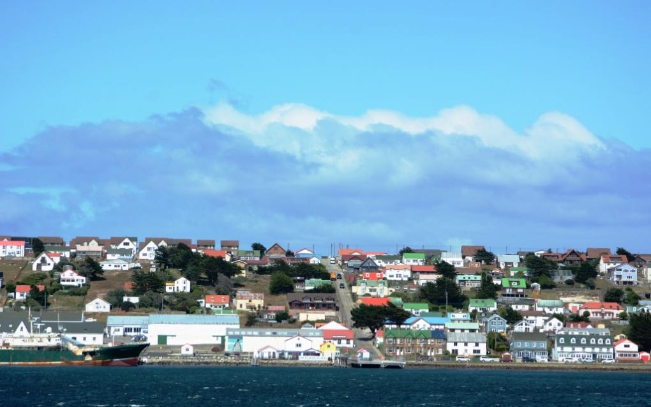
Falkland Islands Company (FIC)

Slide 7
FIC : Trading overview
Year ended 31 March | 2019 | 2018 | Change
 | £ million | £ million | %
Revenue
Retail | 9.72 | 9.19 | 5.7
Falklands 4x4 | 3.05 | 2.92 | 4.5
FBS (construction) | 1.53 | 2.95 | -47.5
Freight & Port services | 0.78 | 0.94 | -17.1
Support Services | 2.00 | 1.78 | 12.4
Property Rental | 0.47 | 0.48 | -0.4
Total FIC revenue | 17.55 | 18.26 | -3.8
FIC underlying profit before tax, before JV | 1.57 | 1.39 | 13.0
Net interest expense | (0.06) | (0.07) | -7.7
SAtCO share of results of Joint venture | - | 0.02 | -100.0
Profit Before Tax | 1.51 | 1.34 | 12.5
Notes:
Not major issue but prior financial slide (p.5) wasn’t rounding to 2 decimal points like this one
Could consider only the negative numbers being in red, with positives in green – an option.

Slide 8
FIC Overview : Year ended 31 March 2019
Revenue lower by 4% at £17.6m (2017: £18.2m) but PBT ahead by 12% at £1.5m.
Retail - Overall sales +5.7% against strong comparatives. Margins improved with richer sales mix.
West Store sales + 4.2%. Strong core supermarket sales offsetting lower activity at MPA base store.
Home Living (home and furniture) sales + 15%.
Home Builder (builders’ merchant & tools) sales + 11%.
FBS (construction) Revenue down 48% at £1.5m - contribution down £0.2m.
Kit home sales down from 22 to 6 units due to delays in release of government building plots.
House building teams directed to expand rental portfolio. 5 new homes completed + 17 started in year.
Record FBS order bank for new kit homes at 31 March 2019.
First government contract to construct 18 homes won in November 2018 – further tenders expected.
Property rental income unchanged at £0.5m due to portfolio modernisation & redevelopment.
4x4 Sales +4.5% to £3.0m (2018: £2.9m).
76 vehicle sales vs 77 but 28 new sales (vs 20) helped vehicle sales revenue & margins.
Lower corporate rental demand for 55 unit hire fleet.
Solid parts and service contribution.
Notes:
Accounts have Total FIC 2018 revenue at £18.26, so £18.3m with rounding?
Retail bullet is the only one with a hyphen before the descriptor/summary line
Delete extra space on Property rental line between modernisation & redevelopment

Slide 9
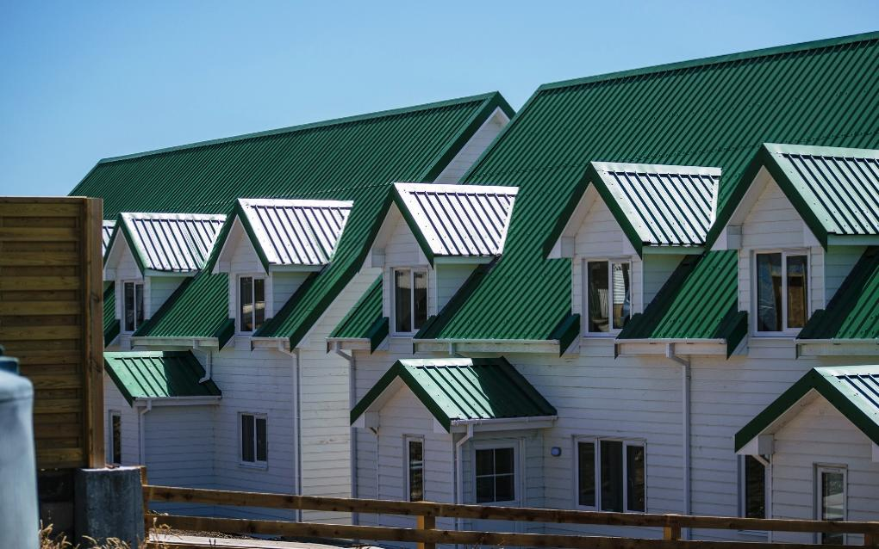
FIC – New rental properties under construction

Slide 10
FIC Overview continued: Year ended 31 March 2019
3rd party freight & Port Services – down 17% due to delays / gaps in MoD supply vessel arrivals – largely timing differences.
Support Services - Revenues + 12.4% to £2.0m.
Fishing Agency – stronger illex squid catch in April / May 2018.
Penguin Travel revenues + 4% - further progress winning new agency contracts with cruise operators.
Professional Training Services added as new income stream.
Insurance & Financial Services – steady progress.
SAtCO – no activity in absence of oil contracts.
Oil Tenders - expressions of interest submitted to Premier Oil for 6 onshore construction & supply contracts – tender process expected to complete in 2019.
FIC – Encouraging performance from core business especially given temporary downturn in FBS kit home sales.
PBT +12.5% at £1.5m (2018: £1.3m).

Slide 11
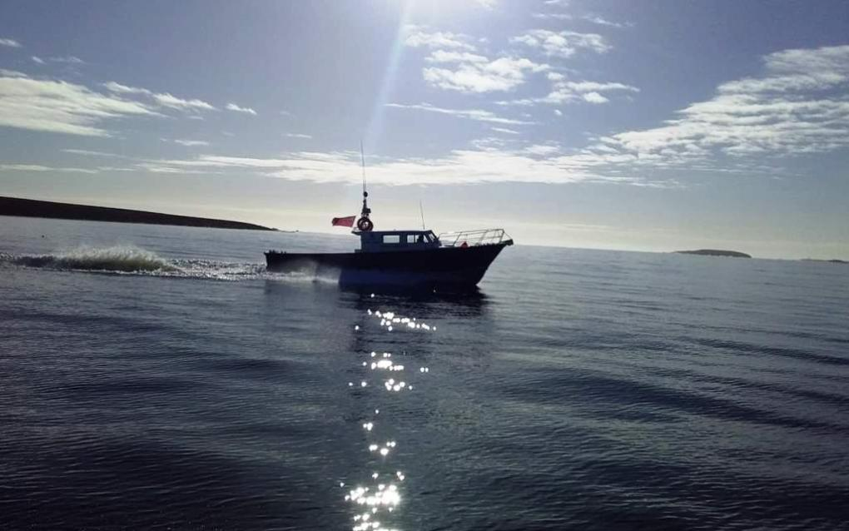
FIC New Agency Launch Delivered November 2018

Slide 12
FIC : Outlook June 2019
Core business stable. Ongoing investment to stay ahead of local competition.
Property rental portfolio being expanded over next 12 months from 50 to 70 units.
Record kit home order book for FBS. Further government and MoD tenders expected for new homes with Sale & Leaseback potential. But strong competition from local and UK competitors .
FI government tender for new port facilities progressing in 2019 but site selection still undecided by government.
Tenders for on-shore oil support services delayed, but expected to be progressed during remainder 2019. Final decision from Premier Oil on Sea Lion expected late 2019 / early 2020.
New air link from Brazil expected late 2019. Once established 2nd flight opens door for expansion in land based tourism and cruise ships / expedition vessels.
Upgrade of air terminal at MPA being progressed.
Other investment opportunities from increased infrastructure spend (FIG and MoD) and development of tourism – potential for lower risk steady returns over long term.

Slide 13
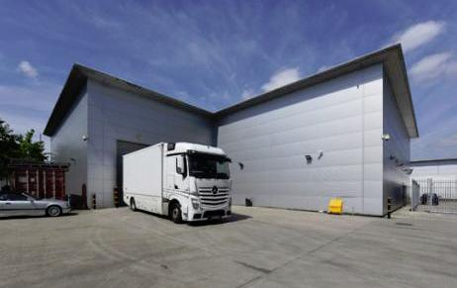
Momart : Fine art storage facilities, Leyton East London

Slide 14
Momart : Year ended 31 March 2019
Overall revenue lower by 2.9% at £20.6m (2018: £21.2m)
Exhibition / Museum revenue down 6.5% with fewer blockbuster UK shows. More focus on outgoing loans with less outsourcing and increased utilisation of Momart in-house services. Revenue £11.0m (2018 £11.8m) - 6.5% but margins ahead on richer sales mix and improved operating efficiency.
GS Revenues + 4.0% to £7.5m.Further growth with Auction Houses and increased activity with commercial Galleries.
Storage income down £0.14m at £2.07m, held back by client losses late in prior year. Encouraging new client wins helped replace losses in H2. Storage space 81% let at year end + 8.1% on prior year. Opportunity in medium term from achieving full utilisation.
Purchase of Leyton property in December 2018 removed exposure to escalating rents and gives some potential for consolidating operations on one site. Boost to net earnings in medium term from rent saving vs interest costs.
2019 result flattered by provision release of £0.2m but good underlying growth.
PBT +51% at £1.57m ( £1.0m)
Notes:
Elsewhere we use symbols for +/- rather than writing in full as “lower by”/ “down”
For the PBT comparable figure, add in (2018: )

Slide 15
Momart : Trading Summary
Revenue | 2019 £ 000’s | 2018 £ 000’s | Change %
Museums & Public Exhibitions | 11,003 | 11,770 | -6.5
Gallery Services | 7,539 | 7,249 | 4.0
Storage | 2,065 | 2,203 | -6.3
Total Revenue | 20,607 | 21,222 | -2.9
Operating Profit | 1,730 | 1,071 | 61.5
HP & Bank Interest | (161) | (34) | 373.5
Pre Tax Profit | 1,569 | 1,037 | 51.3
Operating profit margin | 7.6% | 4.9% | +55.8%

Slide 16
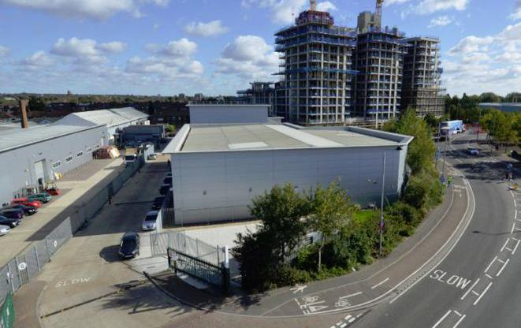
Momart : Leyton Units now 81% full – 19k sq ft to let

Slide 17
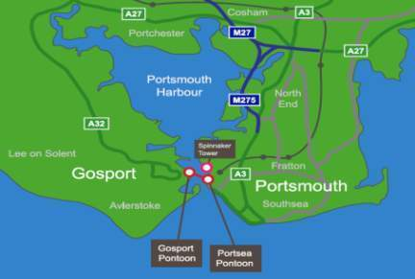
Gosport Ferry (PHFC)

Slide 18
Gosport Ferry (PHFC) – Trading P&L
Revenues | 2019 £ million | 2018 £ million | Change %
Ferry fares | 4.15 | 4.14 | 0.3
Other revenue | 0.22 | 0.21 | 2.4
Total Revenue | 4.37 | 4.35 | 0.4
Operating Profit | 1.08 | 1.18 | -8.1
Interest received | 0.01 | 0.01 | 9.1
Boat mortgage loan interest | (0.08) | (0.10) | -16.8
Pontoon lease finance interest | (0.23) | (0.23) | -0.4
Profit before tax | 0.78 | 0.86 | -8.8
Net margin on revenue (%) | 24.8% | 27.1% | -8.5
Passenger journeys (000s) | 2,556 | 2,612 | -2.1

Slide 19
Gosport Ferry : Year ended 31 March 2019
Ferry revenues ahead by 0.4% at £4.37m (2018: £4.35m).
Fare rises averaging 3% in June 2018.
Adult Return fares £3.60 (June 2017: £3.50) ( £3.70 from June 2019).
10 Trip tickets from £1.60 per adult trip (2017-18: £1.55) (£1.65 from June 2019).
Promotional fares to boost demand (Bikes Go Free / Family Saver tickets, Park & Float).
Bikes accounted for 11% of traffic, Military users 4.0%.
2.56m passenger journeys (2018: 2.61m) -2.1%.
Slow down in rate of attrition -2.1% vs -3.6% and -4.1% in earlier years.
PBT down £0.08m (-9%) at £0.78m (2018: £0.86m).
Underlying cash flow strong.
Outlook – Arrival of 2nd carrier ,Prince of Wales in late 2019. Steady redevelopment of former MoD sites and infrastructure over medium term.
Notes:
In outlook, comma to come straight after “carrier”, with space before “Prince of Wales”

Slide 20
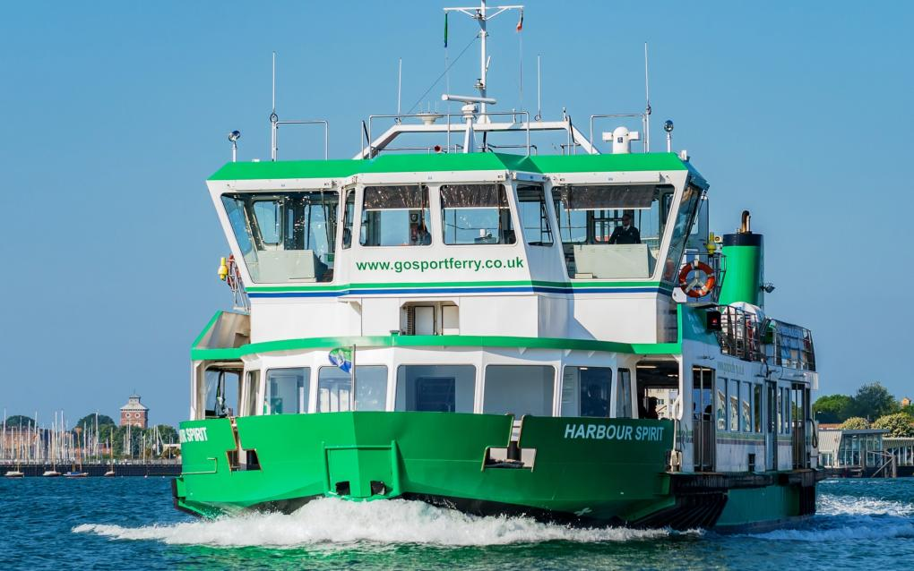
Gosport Ferry (PHFC)

Slide 21
FIH : Strategy
Group:
Focus on maximising opportunities from existing group operations.
FIC:
Invest in and maintain strength of core business.
Expand rental portfolio and construction arm.
Utilise established partnerships to bid for government infrastructure and oil related projects.
Expand support services offering to develop outsourcing opportunities from government and MoD.
Momart :
Focus on filling storage capacity of £20k sq ft (+ £0.5m pa).
Maintain brand reputation as market leader in quality & service.
PHFC:
Maintain steady profits & strong cash flow.

Slide 22
Outlook - June 2019
FIC:
Record FBS order book and increase in FIC rental portfolio will provide boost in FY 2019-20.
More limited illex squid catch April / May 2019 but no serious impact.
Tenders from Premier Oil for Sea Lion on-shore services expected in H2 2019.
Premier seeking UK govt backing for loan guarantees in mid 2019 and ideally farm-in partner. Final Investment Decision expected late 2019 / early 2020.Outlook for oil price key factor.
FIG tender for new port progressing from June 2019
New air link to Brazil expected November 2019 offers prospect of long term development of tourism if sustained.
FIG/ MoD housing and infrastructure projects offer significant opportunities.
Momart :
Consolidation of performance in 2019-20 after strong growth in 2018-19.
Slower start to 2019-20 as expected, some exposure to disruption from a disorderly Brexit.
Focus on filling new storage facilities to leverage profit growth in medium term.
PHFC :
Steady trading and cash performance expected.
Prince of Wales carrier due late 2019 – further expansion of Portsmouth naval base.
Overall:
Solid profitability and strong cash flow to be maintained in near term – a year of consolidation.
Sound long term prospects for all 3 group businesses.
Notes:
Prince of Wales spacing

Slide 23
Appendices
Cash Flow, Balance Sheet, Net Borrowings & Liquidity.

Slide 24
Cash flow - for the year ended 31 March
Cash Flow | 2019 £’000 | 2018 £’000
Operating profit | 4,377 | 3,633
Depreciation and amortisation | 1,437 | 1,692
Provision for share based payments | 69 | 37
Takeover costs paid | - | (165)
Tax paid | (560) | (475)
Increase in working capital | (2,553) | (573)
Fall in HP debtors & cash in/(out) on share option exercises | 313 | 109
Net Cash Flow from Operations | 3,083 | 4,258
Capital expenditure | (22,432) | (803)
Dividends paid | (579) | (683)
Other | 36 | 105
 | (22,975) | (1,381)
Increase / (reduction) in Bank Borrowings and HP | 9,058 | (938)
Total (decrease) / increase in Cash | (10,834) | 1,939

Slide 25
Balance sheet
All figs £ ‘000’s | 31 March 2019 | 31 March 2018
Tangible Fixed Assets | 38,664 | 18,845
Investment properties at net book value | 5,239 | 4,045
Goodwill & Intangibles | 11,766 | 11,832
Deferred tax asset & HP due after 1 year | 1,652 | 1,608
Total non current assets | 57,321 | 36,330
Working Capital - Net | 4,555 | 2,159
Cash | 6,184 | 17,018
Corporation tax payable | (399) | (346)
Bank Loans etc due within 1 year | (10,645) | (631)
Net Current Assets | (305) | 18,200
Bank Loans etc due after 1 year | (2,453) | (2,905)
Finance Lease re Pontoon due after 1yr | (4,695) | (4,730)
Pension Provisions & Def. Tax | (5,301) | (5,162)
Equity Shareholders funds | 44,567 | 41,733

Slide 26
Borrowings, Cash & Liquidity
All figs £ ‘000’s | 31-Mar | 31-Mar
 | 2019 | 2018
Bank Loans* | (12,814) | (3,329)
HP on Momart Trucks | (248) | (173)
Total borrowings & HP | (13,062) | (3,502)
Net (debt) / cash | 6,184 | 17,018
Net (debt) / cash excl 50 year Pontoon lease | (6,878) | 13,516
Long term Pontoon Finance Lease | (4,731) | (4,764)
Total Net (debt) / cash | (11,609) | 8,752
*Bank loan interest: 2.50% on £10,000,000 short term facility

